Slide 1
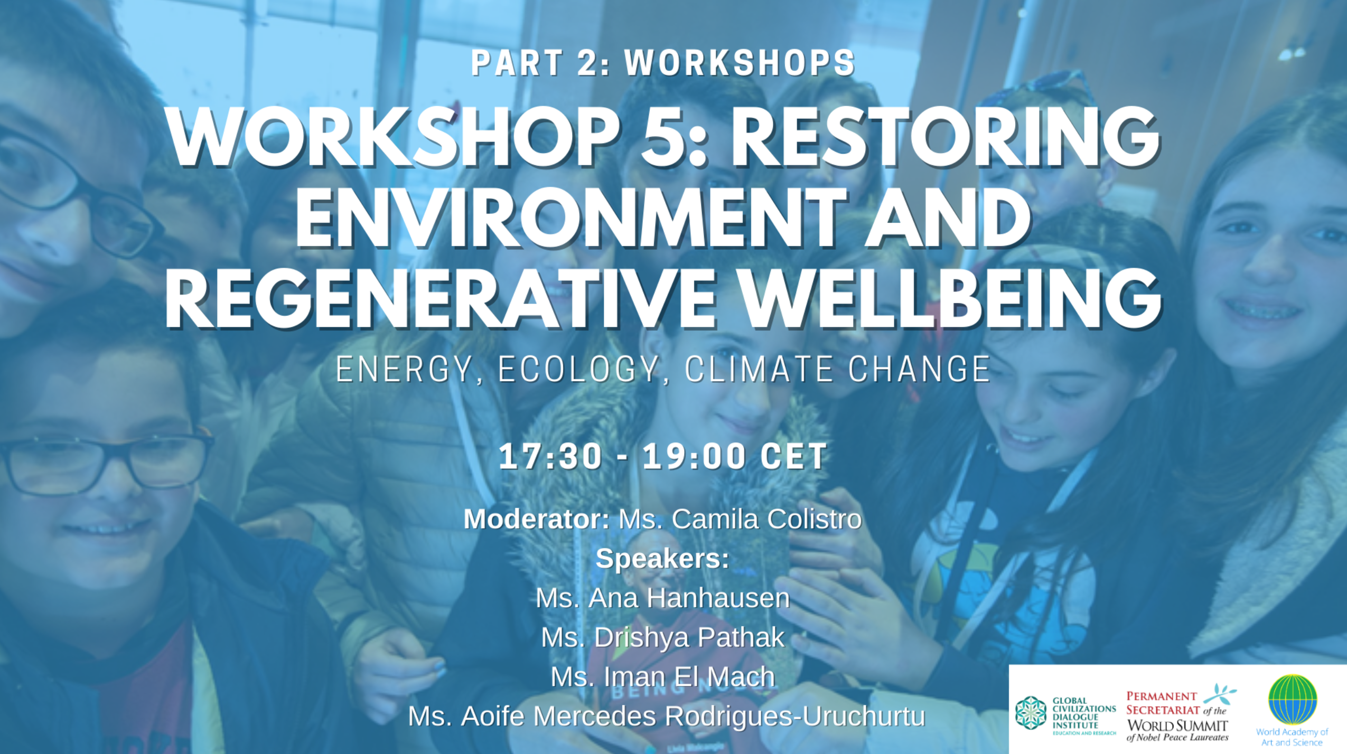

Slide 2
pop
Notes:
Hello and welcome (…)

Slide 3
List of contents
Our team
At which Sustainable Development Goals are we focused on
Work with young people
… and with other age groups
Raise awarness among the school community
Our supporter in our city
Our recent project
Our homepage

Slide 4
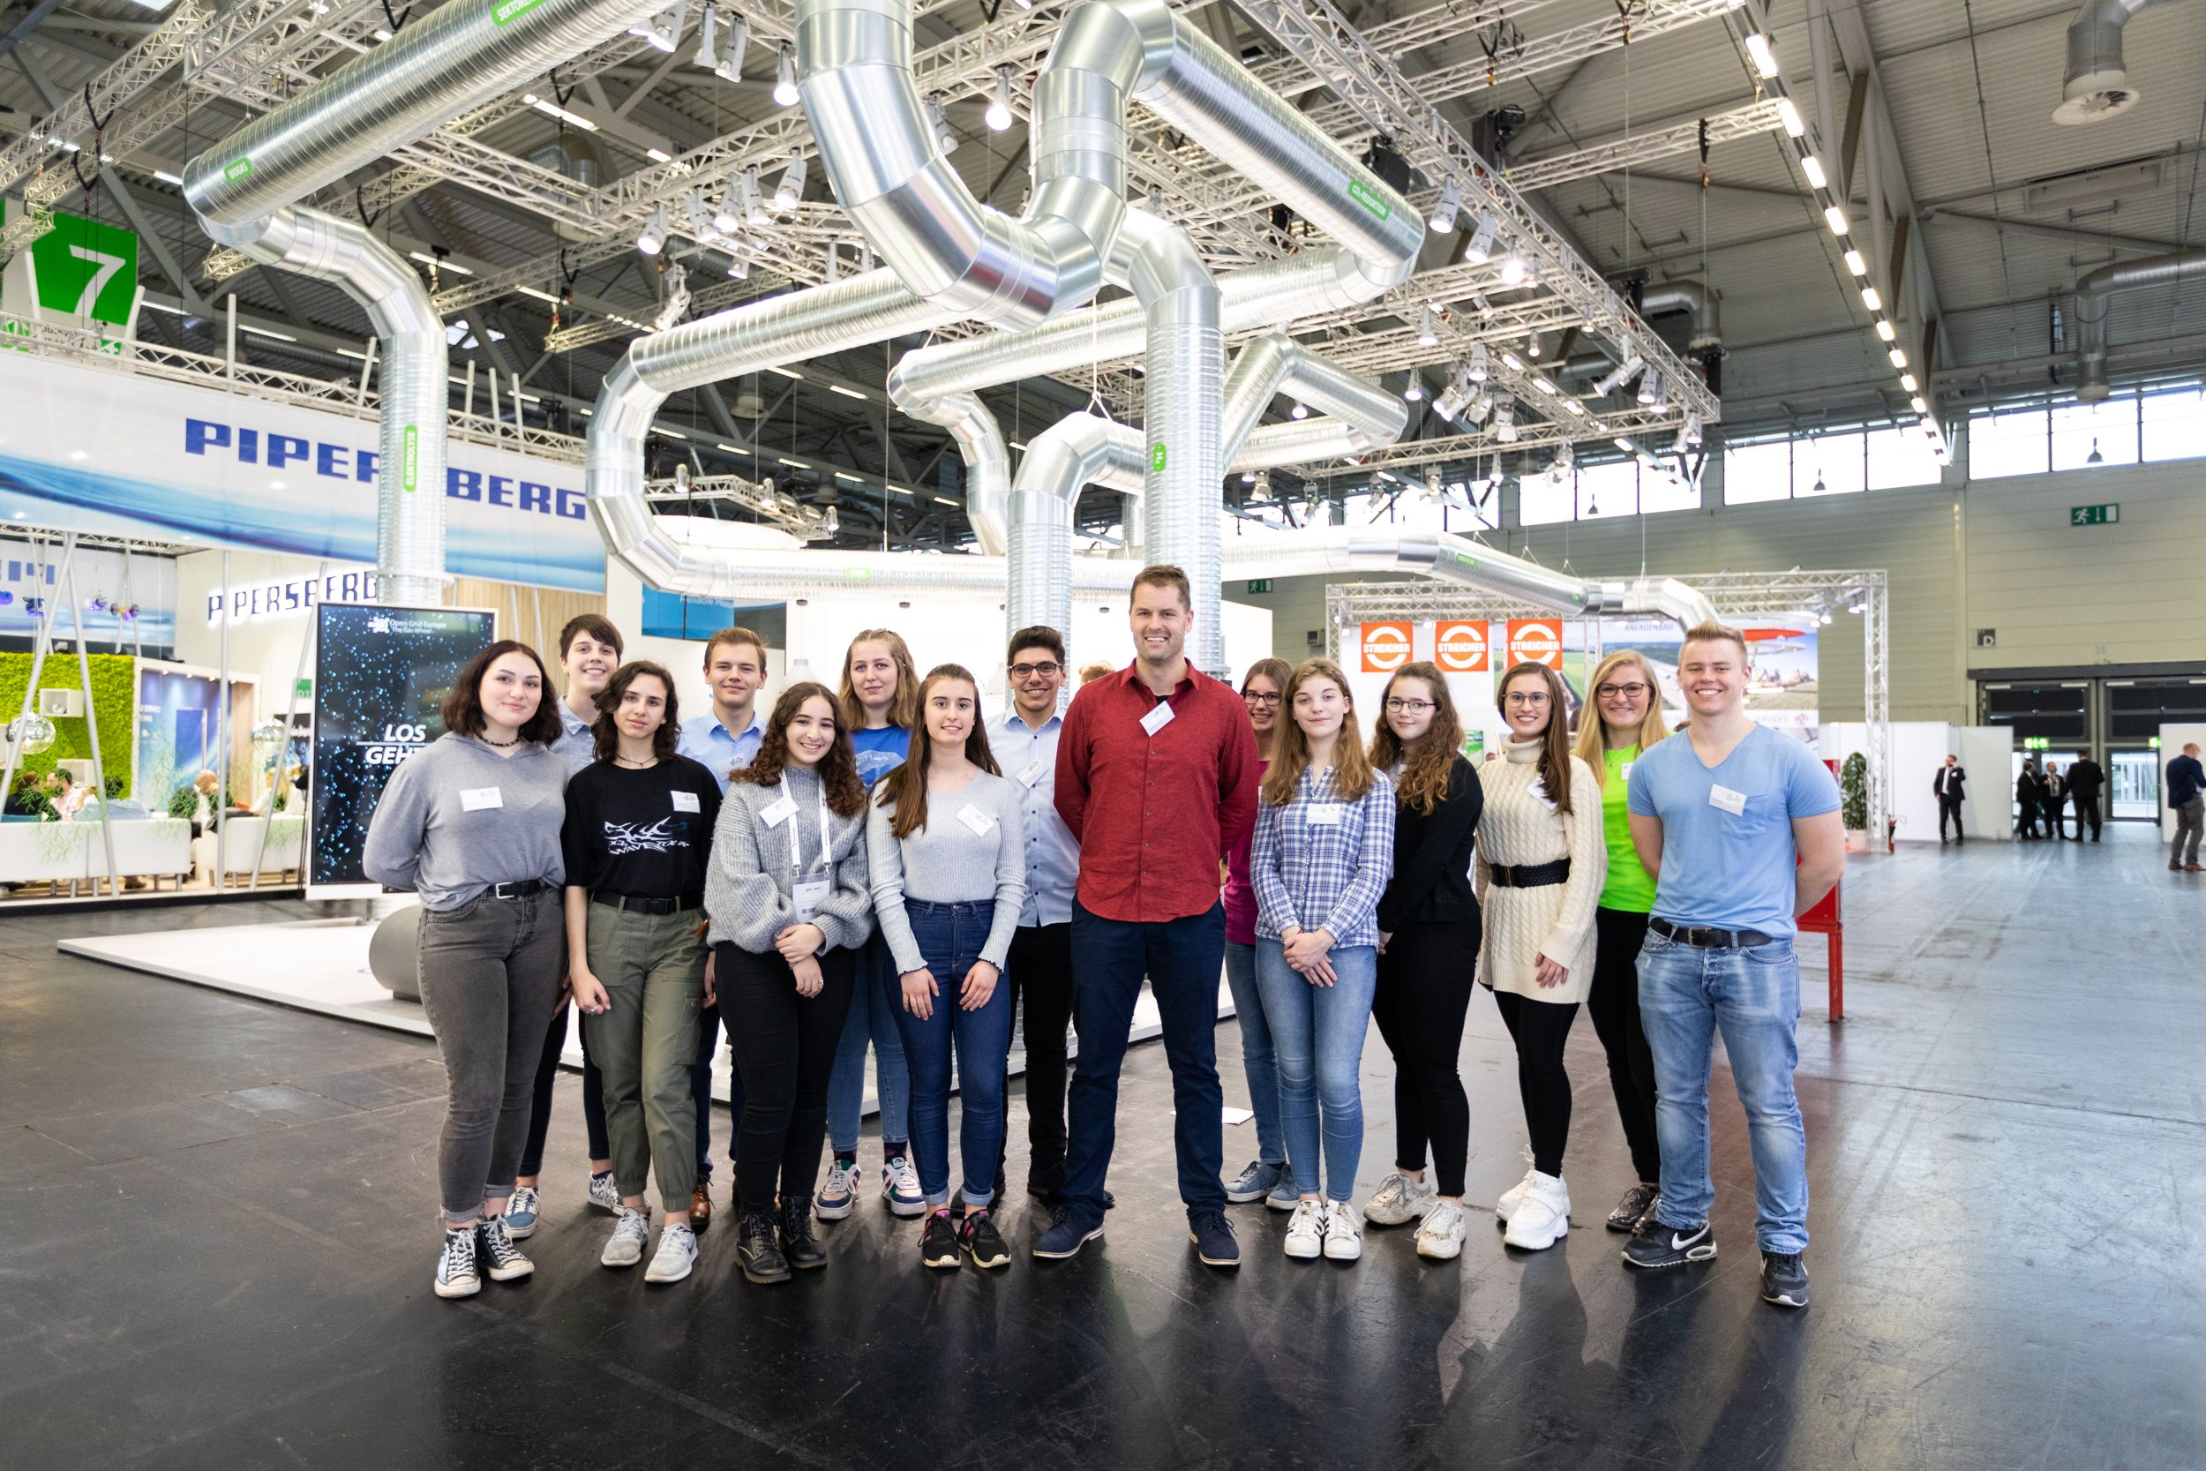
Our team

Slide 5
Notes:
We work with the sdg, but if we would work with all goals we would have a lot to do so we focusede on only two of them. The first ist goal 7 (affordable and clean energy) and second of all goal 13 (climate action). There are, however, clear links to other goals related to different issues. Lowering CO2 emissions comes first, because among other causes of climate change, CO2 is a greenhouse gas that is responsible for the human-made greenhouse effect and for global warming.

Slide 6
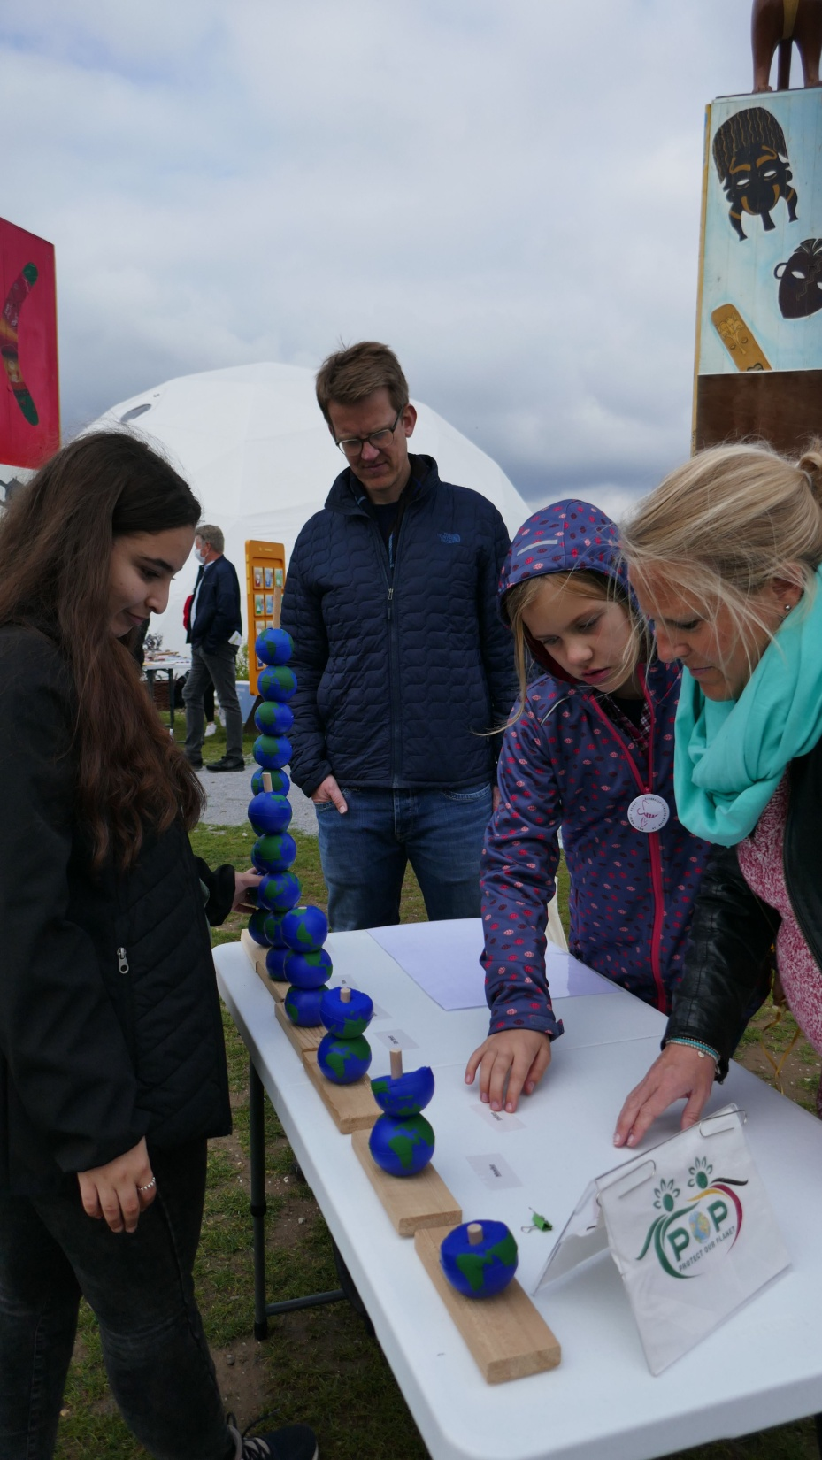
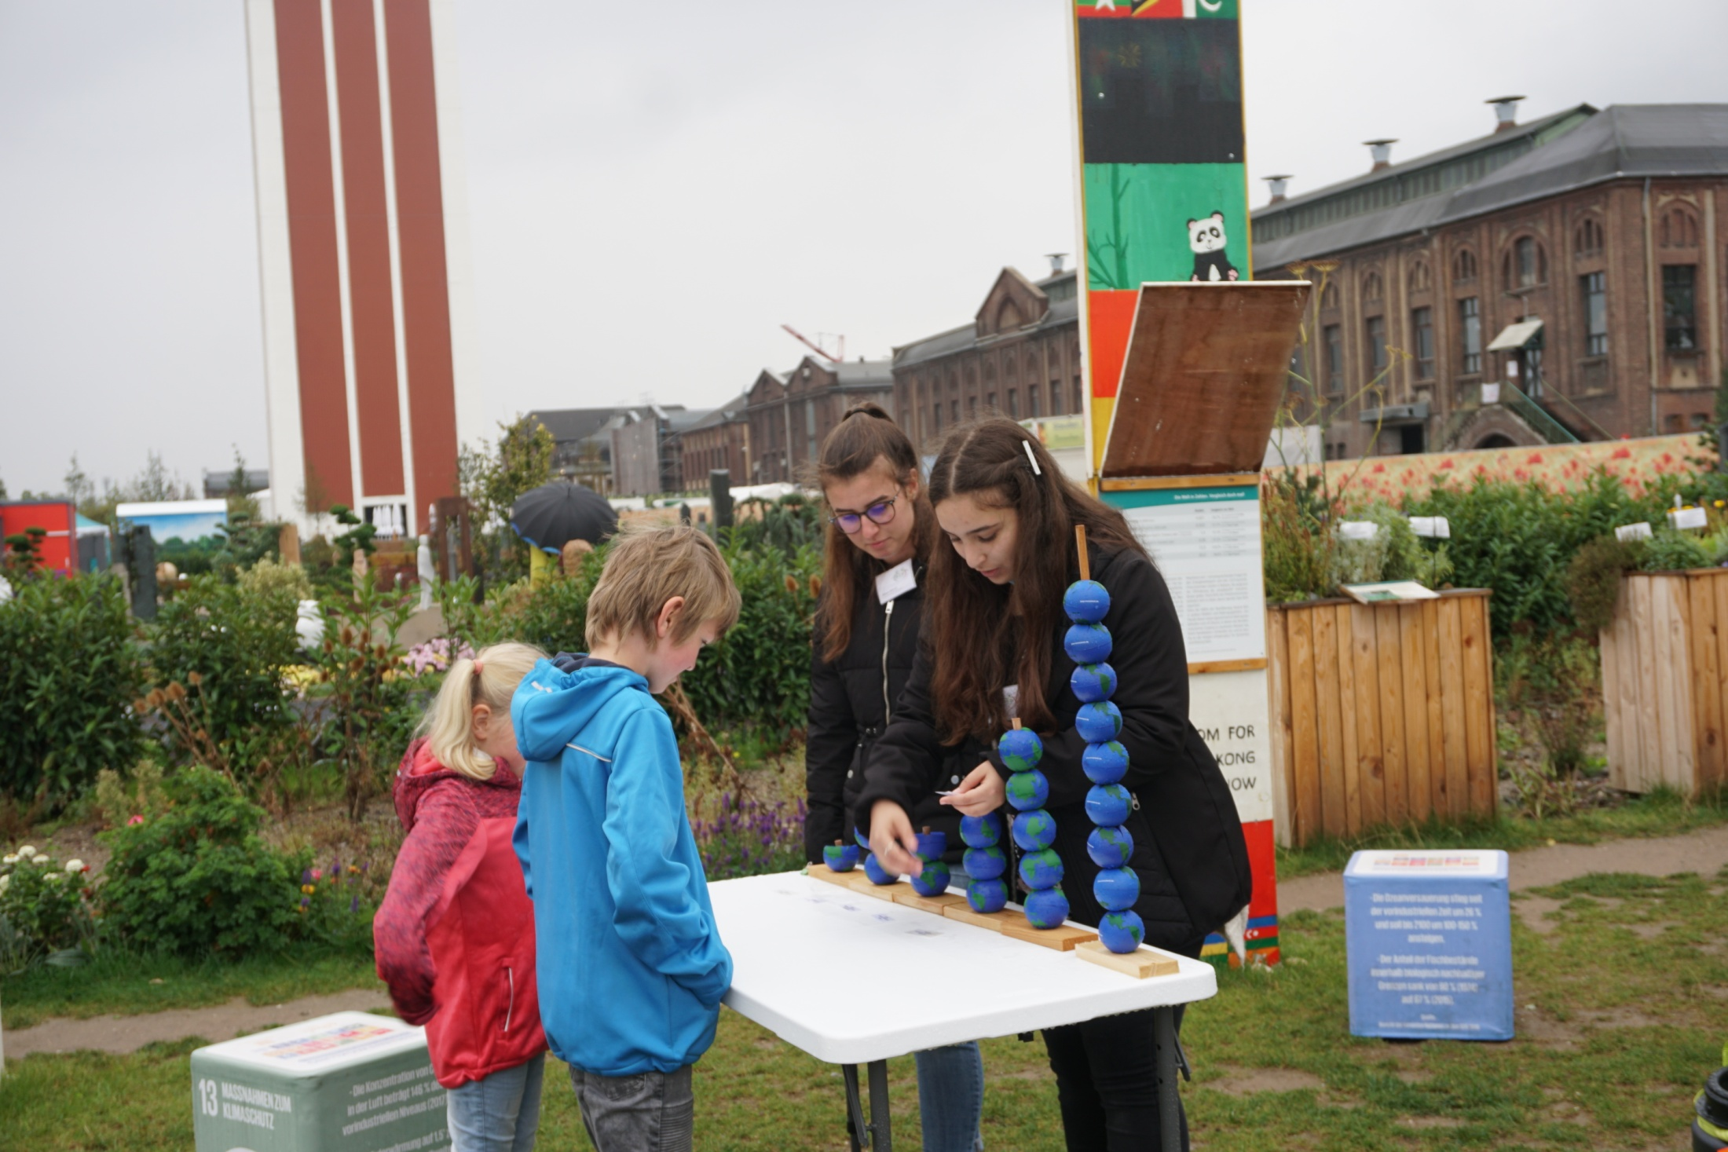
We work with young people
Notes:
One of our goals is to create awareness for measures that reduce CO2 emissions outside school life. One of Our three guiding principles is that Young human beings raise awareness among other (young) human beings; This will not be achieved by wagging one’s finger at others;

Slide 7
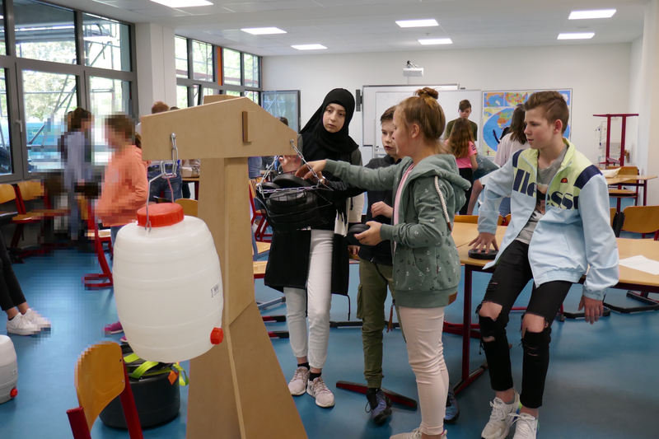
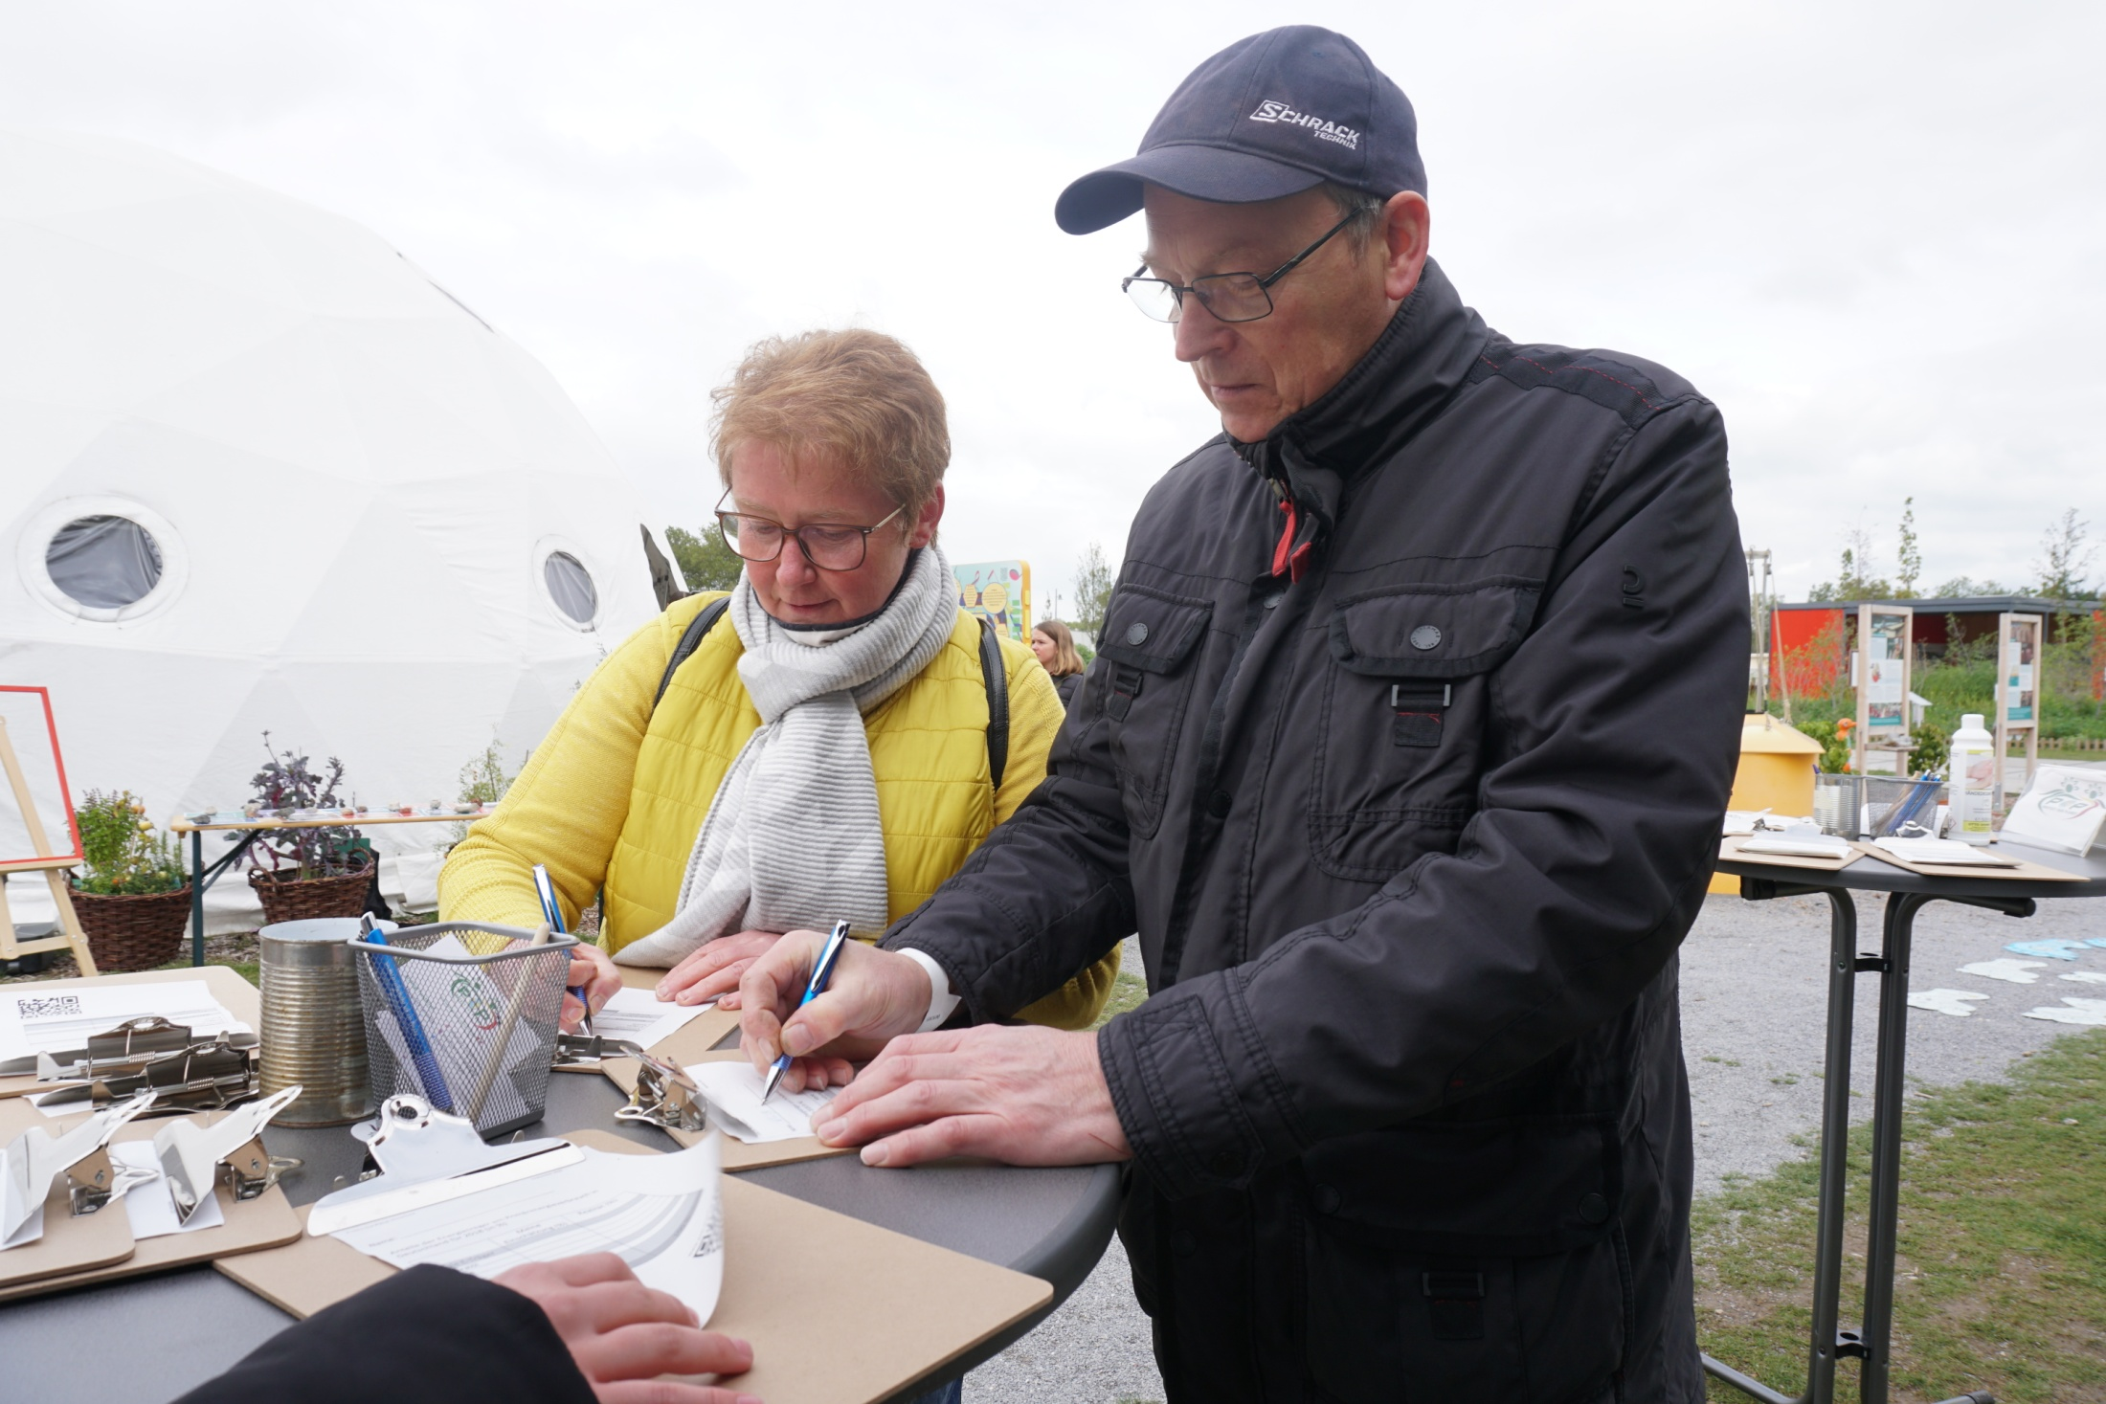
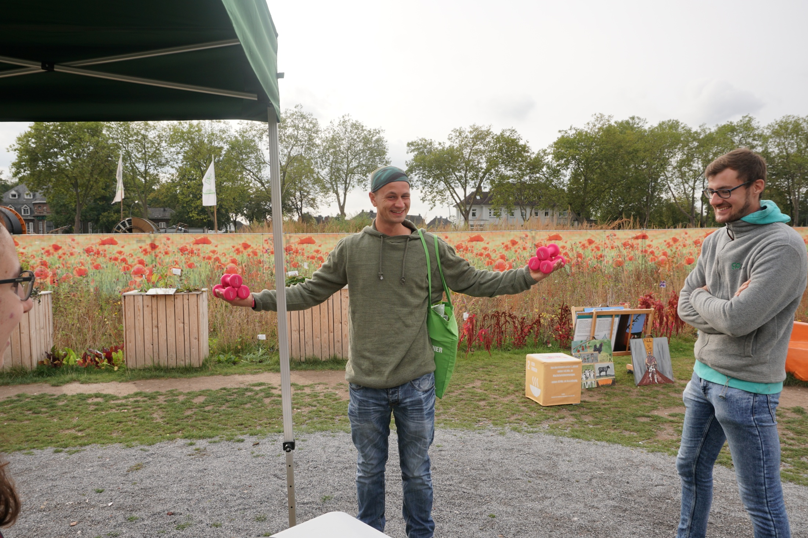
… and we work with other age groups too
Notes:
The POP-Movement’s initiatives are not restricted to school, but succeed by creating a network with people in the surrounding environment. We create awareness not only for young people but for all human beings because we want to give all generations an opportunity to overthink and change the world what will not be achieved by wagging one’s finger at others;
​
The POP-Movement’s initiatives are not restricted to school, but succeed by creating a network with people in the surrounding environment.
​
The POP-Movement’s initiatives are not restricted to school, but succeed by creating a network with people in the surrounding environment.
​

Slide 8
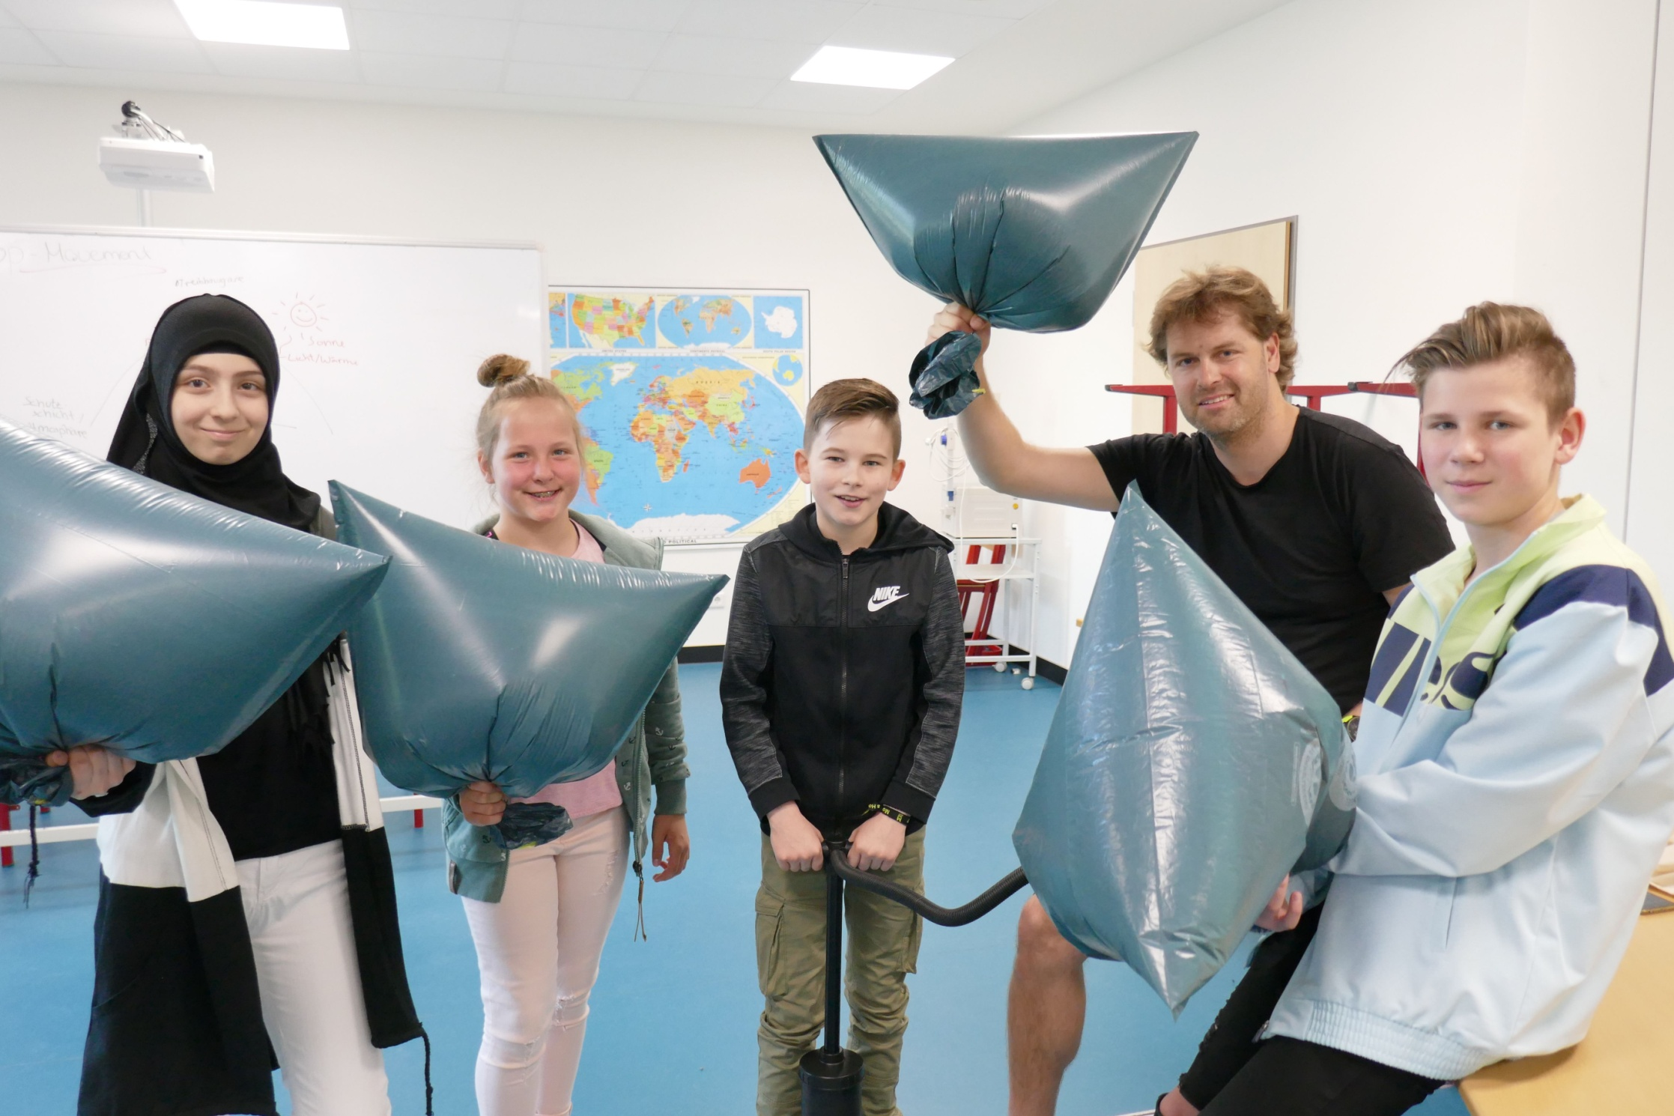
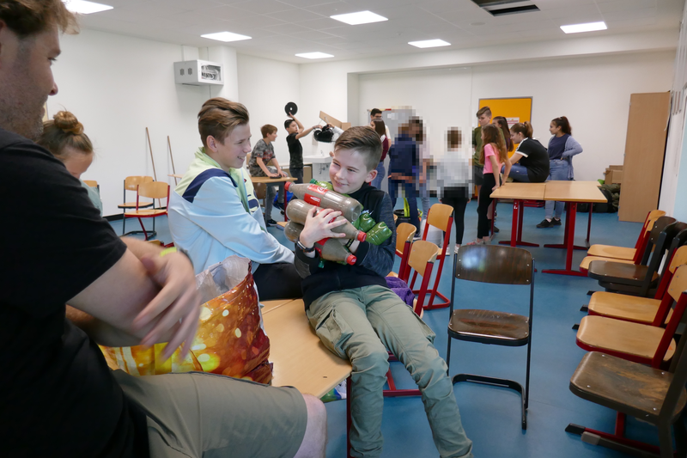
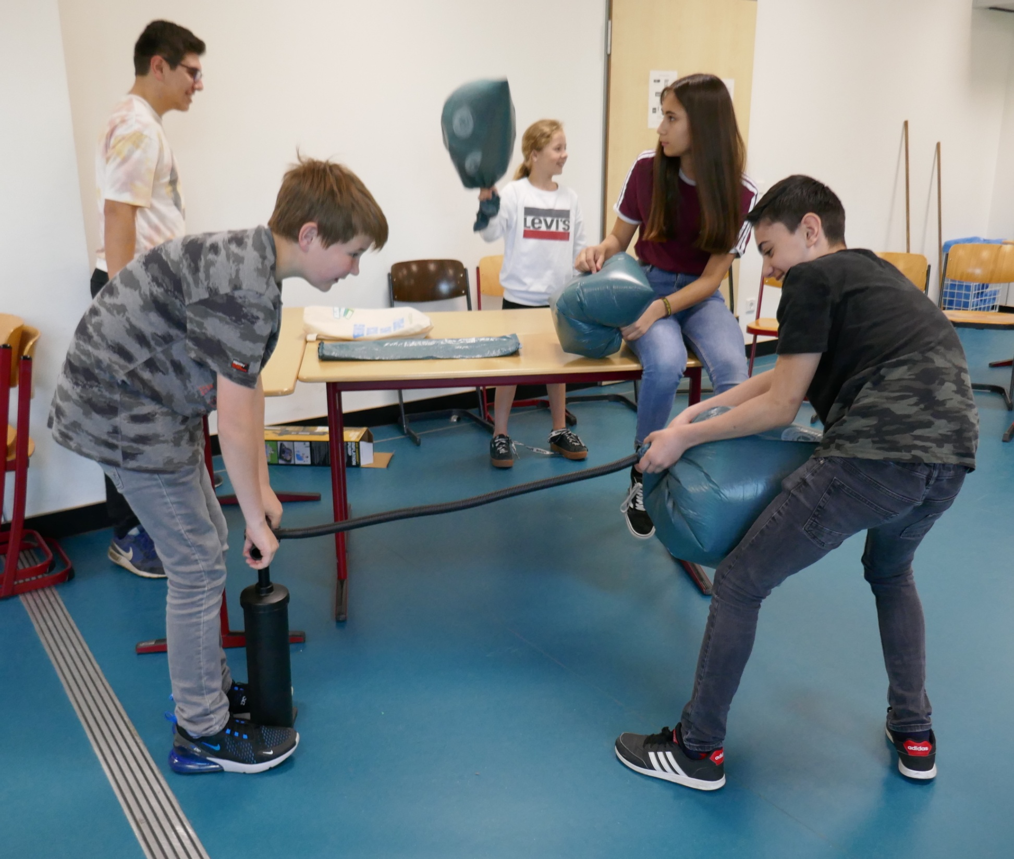
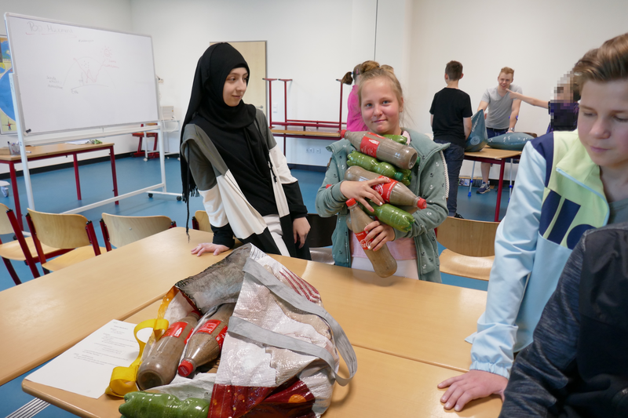
Raise awarness among the school community
Notes:
One of our goals is reducing CO2 emissions at school, by implementing new eco-friendly measures. To talk about our philosophy you can say that
Our environment is far too beautiful, too diverse and too important for allowing it to be destroyed. In order to make it possible for following generations to experience this unique environment, we want to help in an active way and solve future problems, by acting together instead of just making plans.
Because we are of the opinion that too little is done for the protection of our environment and more regard should be given to this issue, it is our aim to raise more awareness for environmental challenges among the future generation and be strong together as a group.

Slide 9
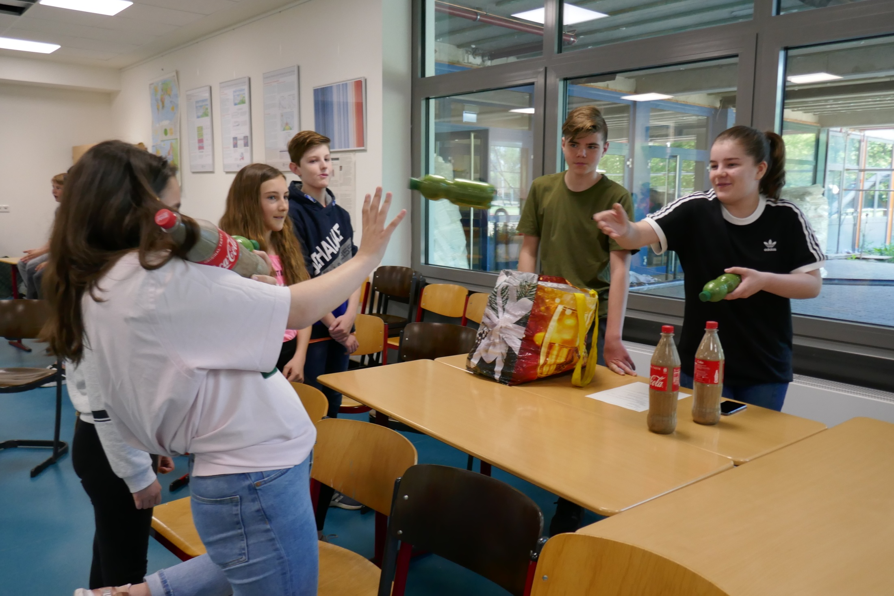

Slide 10
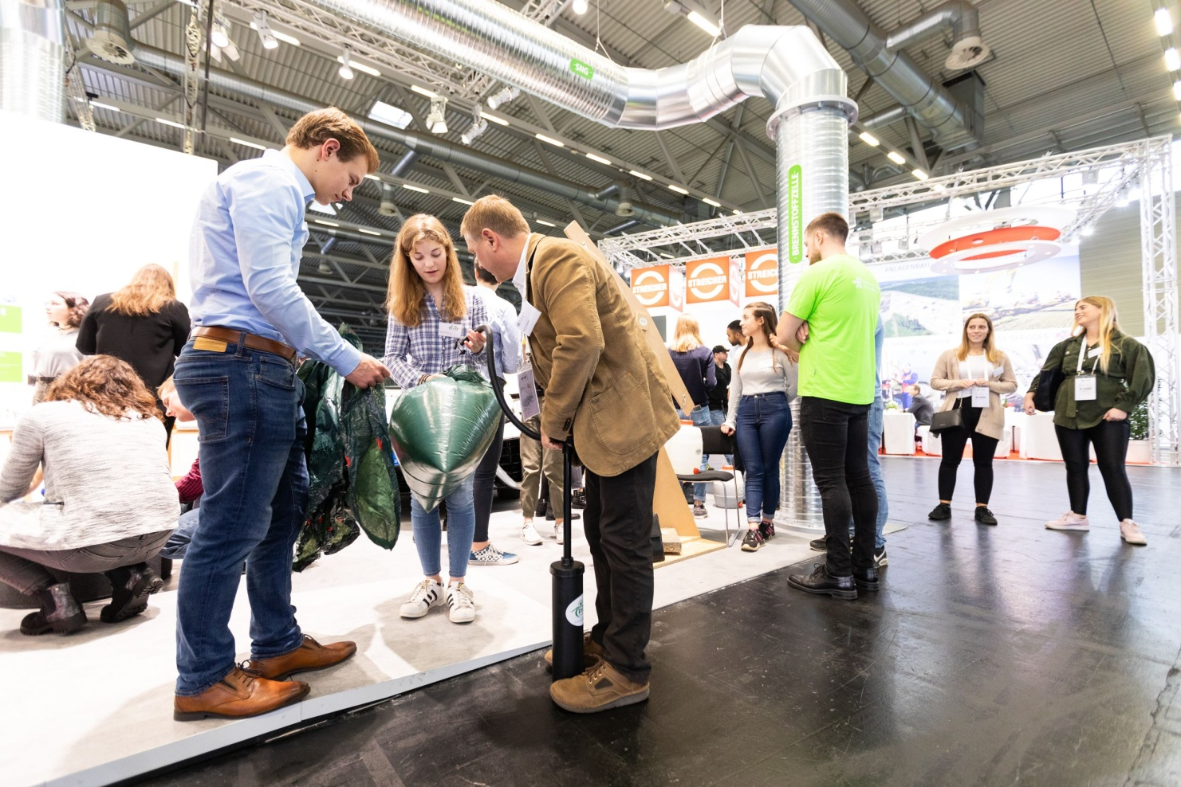
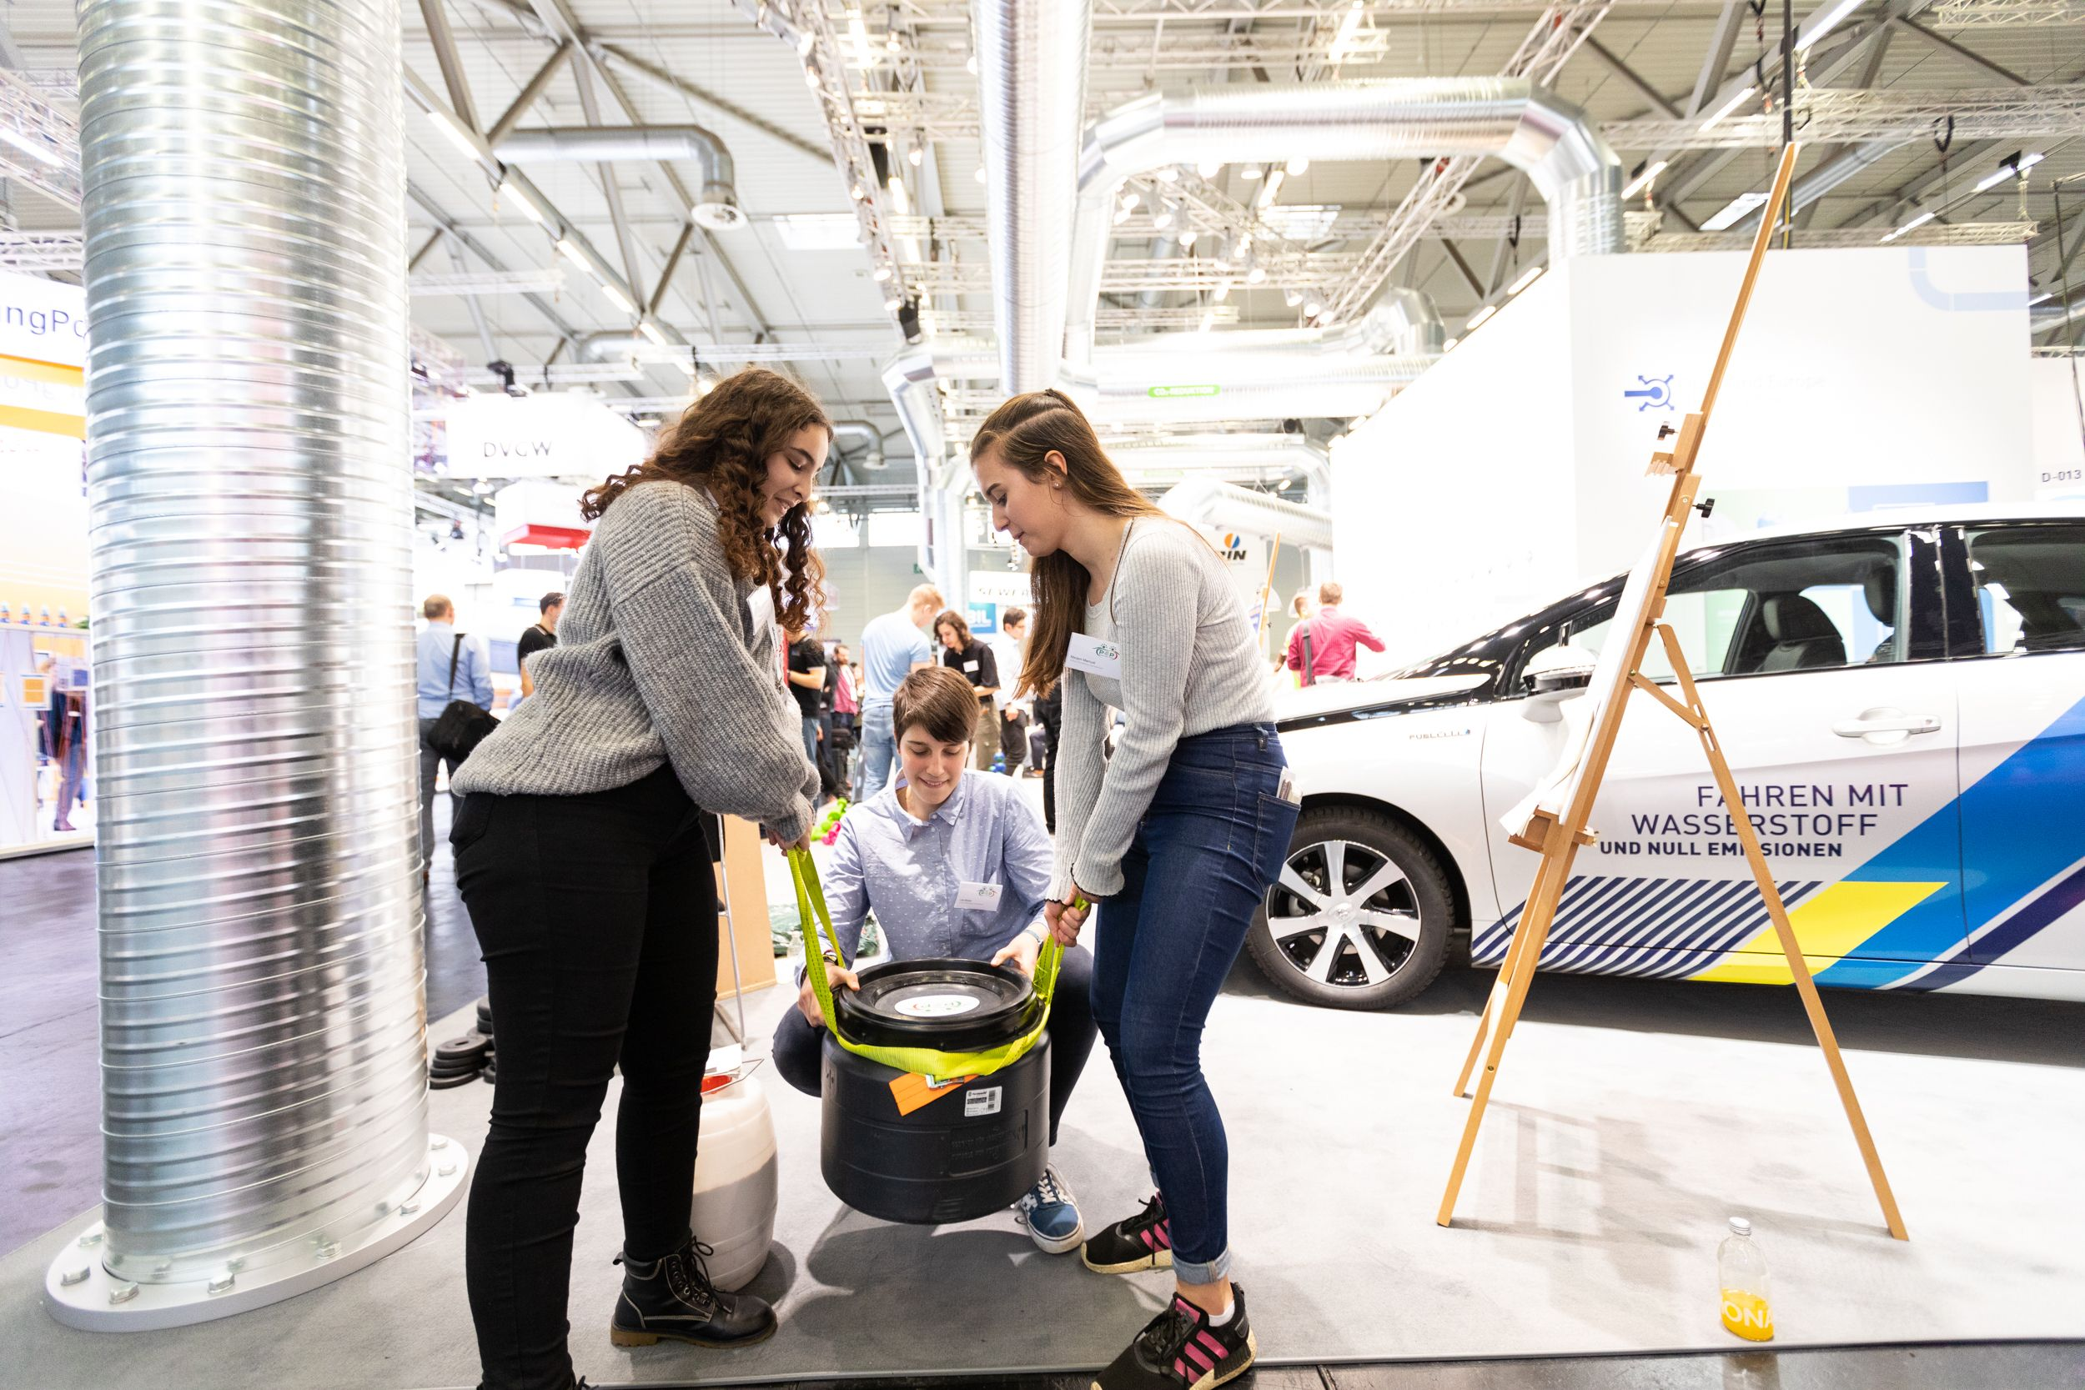
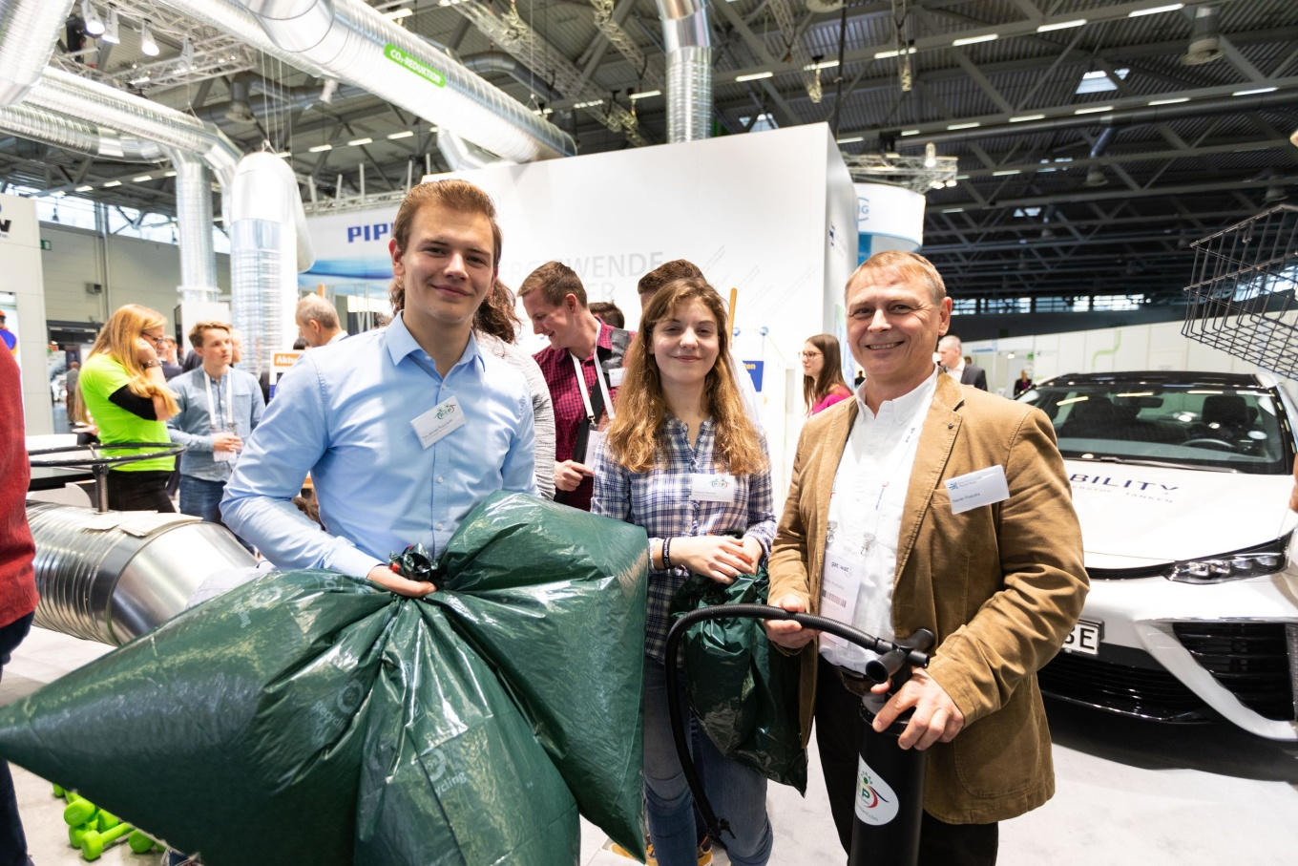
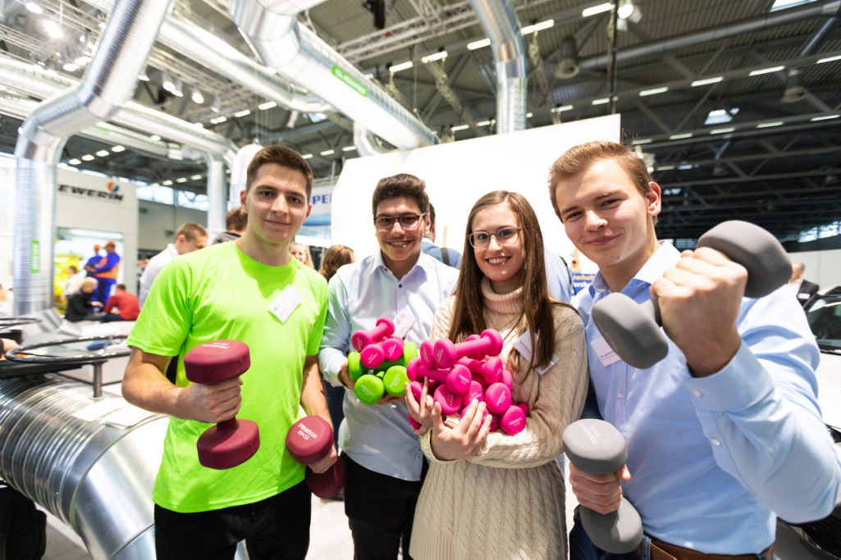
Notes:
These are impressions from the gat/wat a gas fair. We stood there at the place of the OGE which is the greatest gas transporter in germany. We made this contact because of one of our former students (who woked there. )

Slide 11
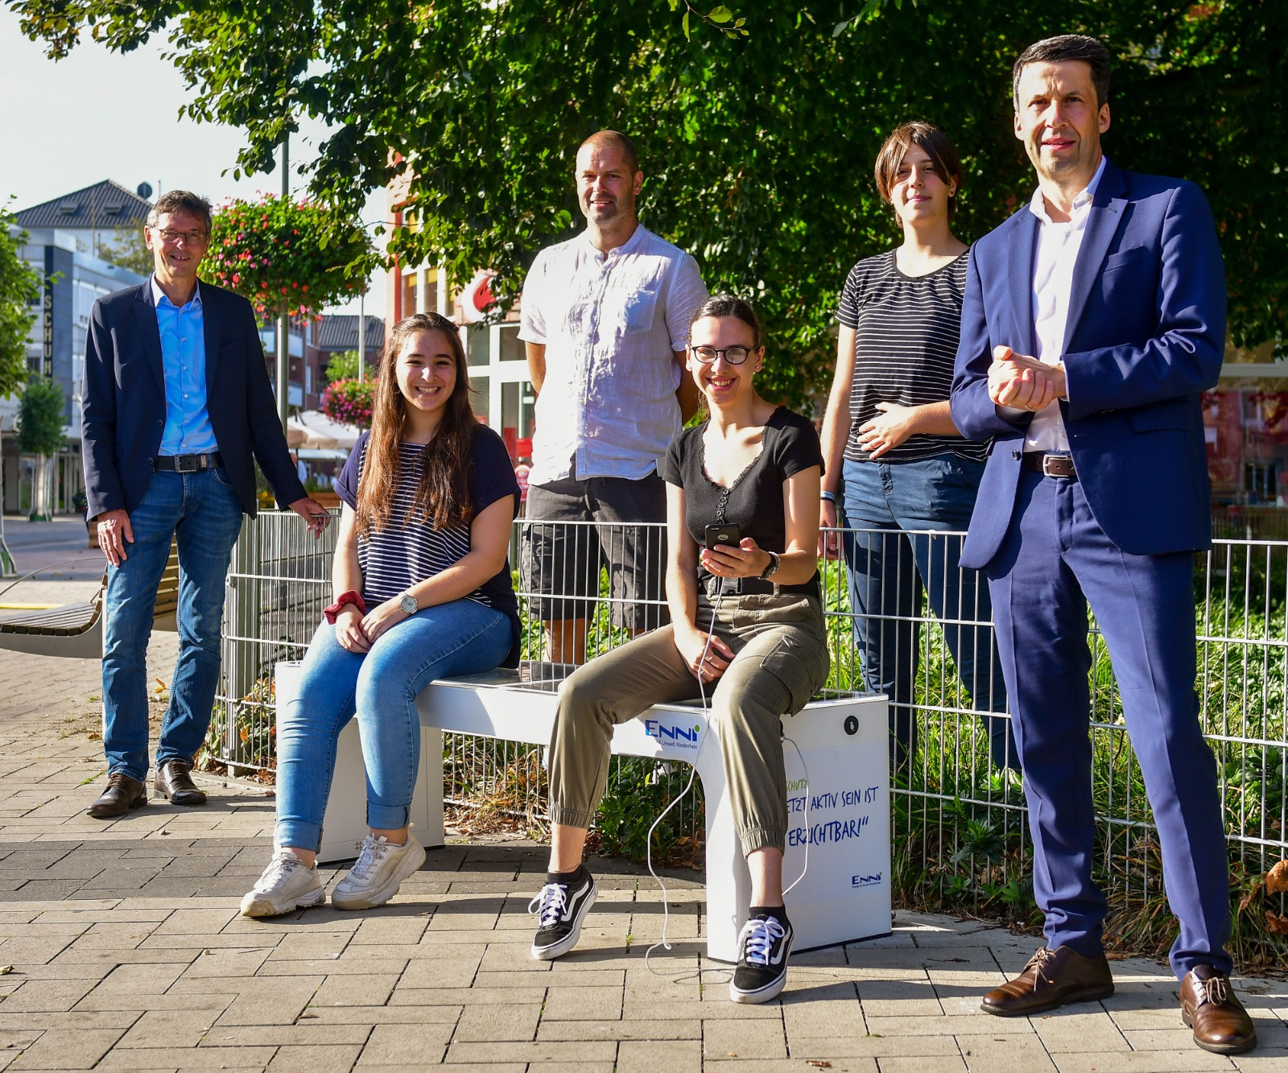
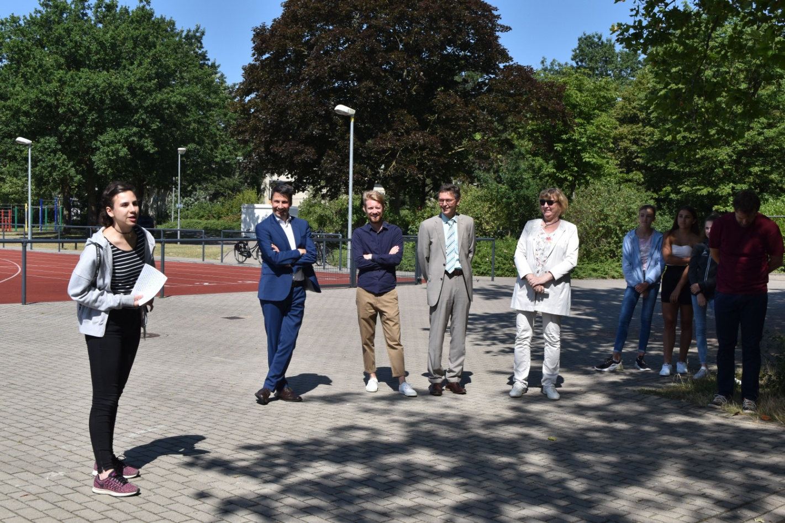
Our supporter in our town
Notes:
We made contacts in all over Germany, like you see in the pictures. Our contact in the free economy is CEO of ENNI Stefan Krämer, at the city hall we have contacts to the climat protection manager Stepan Baur and the former mayor Harald Lenßen. (Mrs. Dr. Marten-Cleef)

Slide 12
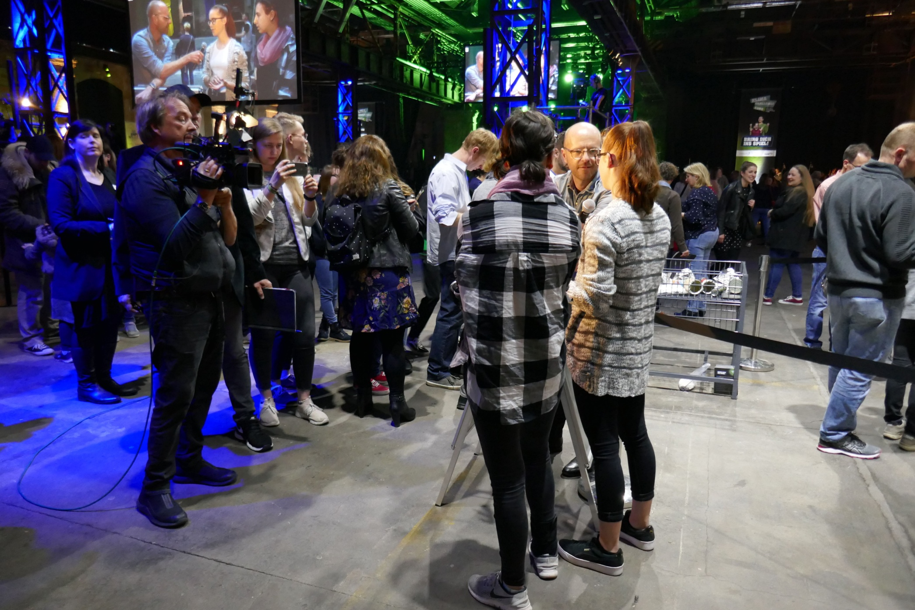
Notes:
We make interviews for example at the climate challenge ruhr closing event as you can see in this picture ond also for the press.

Slide 13
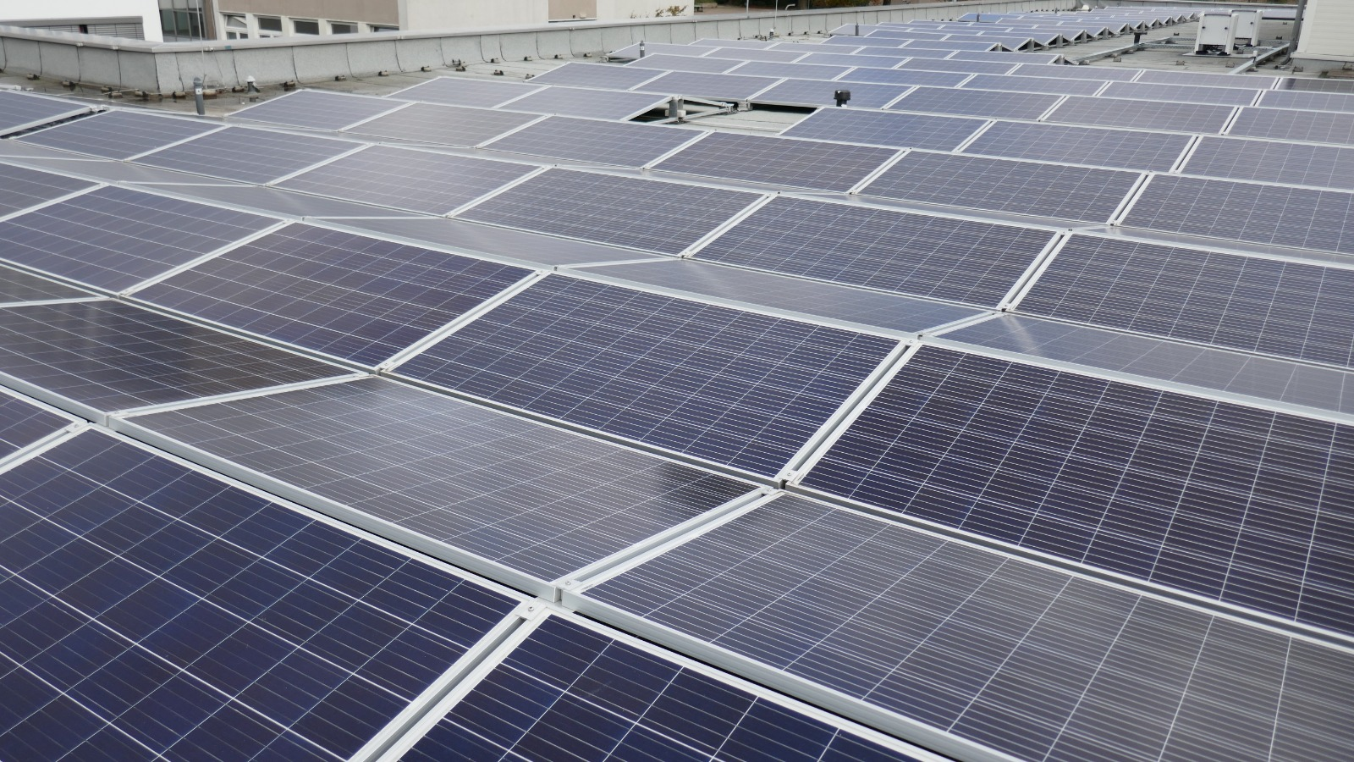
Our recent project
Notes:
Here you can see the photovoltaik system on the roof top of our school. Ist working since february and saved around 20 tones of co2 this year.

Slide 14
Pop-movement.com

Slide 15
Thank you very much for your attention. I hope you´ve enjoyed the presentation.

